Slide 1
Principles of Economics
Final termTopic 3
Business Cycle and Unemployment

Slide 2
Macroeconomic Instability
Economic Growth
Business Cycle
Unemployment
Inflation

Slide 3
Economic Growth
Economists define and measure economic growth as either:
An increase in real GDP occurring over some time period
An increase in real GDP per capita occurring over some time period.

Slide 4
Economic Growth
If real GDP was $ 200 billion in some country last year and $ 210 billion this year, the rate of growth would be 5 percent.
Rule of 70:
Approximate number of years required to double real GDP = (70 / annual percentage rate of growth)

Slide 5
Example : Let’s say : RGDP 2021= 80 million dollars
RGDP 2022= 100 million dollars
Question : How many years approx. it will take to double the RGDP?
Solution: rate of growth = 100-80/80*100= 25%
Approx years = 70/25 = 2.8 years

Slide 6
The Business Cycle
The term business cycle refers to alternating rises and declines in the level of economic activity.
Decline in real GDP leads to significant increases in unemployment.
Rapid economic growth has been marred by rapid inflation.

Slide 7
The Business Cycle
The term business cycle refers to alternating rises and declines in the level of economic activity.
Decline in real GDP leads to significant increases in unemployment.
Rapid economic growth has been marred by rapid inflation.

Slide 8
The Business Cycle
Growth Trend
Level of real output
Peak
Recovery
Recession
Trough
Time

Slide 9
Phases of the Business Cycle
Peak:
→ at a peak business activity has reached a temporary maximum.
→ the economy is at full employment.
→ very close to full productivity.
The price level is likely to rise during this phase.

Slide 10
Phases of the Business Cycle
Recession:
→ a period of decline in total output, income, employment, and trade.
→ wide spread contraction of business activity.
The price level is likely to fall.

Slide 11
Phases of the Business Cycle
Trough:
→ output and employment bottom out at their lowest levels.
→ the trough phase may be either short lived or quite long.

Slide 12
Phases of the Business Cycle
Recovery:
→ in the recovery phase, output and employment rise toward full employment.
The price level may begin to rise before full employment and full capacity production return.

Slide 13
Unemployment
The labor force consists of people who are able and willing to work.
Both those who are employed and those who are unemployed but actively seeking work are counted as being in the labor force.

Slide 14
BLS divides population into 3 groups:
  Employed: paid employees, self-employed,
  and unpaid workers in a family business
  Unemployed: people who were available and not working but who have looked for work during previous 4 weeks
  Not in the labor force: those who do not fit either any of the above two categories. i.e. full-time student, homemaker, or retiree
The labor force is the total # of workers, including the employed and unemployed.

Slide 15
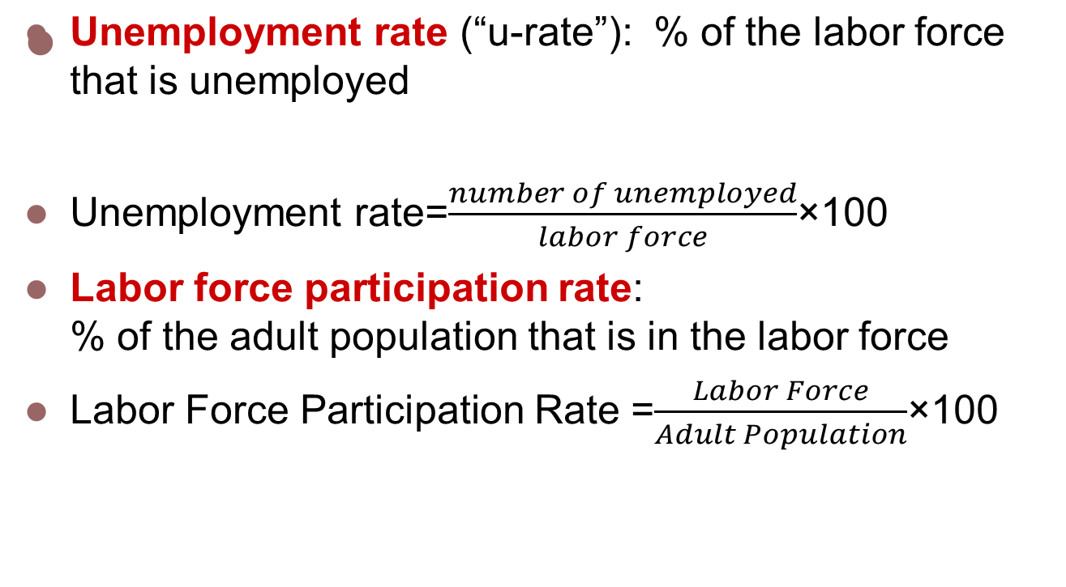
Labor Force Statistics

Slide 16
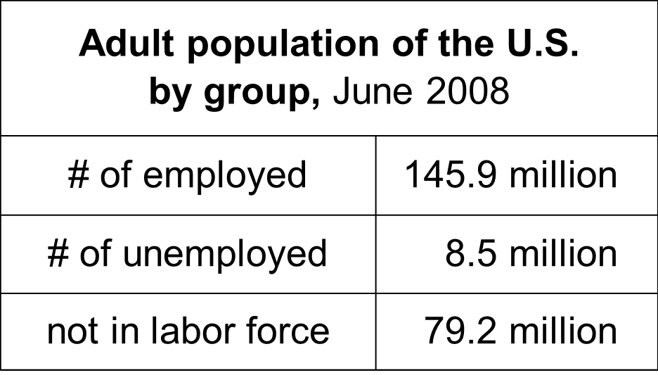
Compute the labor force, u-rate, adult population, and labor force participation rate using this data:

Slide 17
Answers
Labor force = employed + unemployed
= 145.9 + 8.5
= 154.4 million
U-rate = 100 x (unemployed)/(labor force)
= 100 x 8.5/154.4
= 5.5%

Slide 18
Answers
Population = labor force + not in labor force
= 154.4 + 79.2
= 233.6
LF partic. rate = 100 x (labor force)/(population)
= 100 x 154.4/233.6
= 66.1%

Slide 19
Unemployment
The unemployment rate is the percentage of the labor force unemployed:
Unemployment rate= (unemployed / labor force) X 100

Slide 20
Types of Unemployment
There are three types of unemployment:
→ Frictional Unemployment
→ Structural Unemployment
→ Cyclical Unemployment

Slide 21
Frictional Unemployment
Frictional unemployment consisting of search unemployment and wait unemployment.
The word frictional implies that the labor market does not operate perfectly in matching workers and jobs.

Slide 22
Why Frictional Unemployment is inevitable ?
Sectoral shifts
These shifts are changes in the composition of demand across industries or regions of the country.
Such shifts displace some workers, who must search for new jobs appropriate for their skills & tastes.
The economy is always changing, so some frictional unemployment is inevitable.

Slide 23
Structural Unemployment
Structural unemployment results because the composition of the labor force does not respond immediately or completely to the new structure of job opportunities.
Structurally unemployed workers find it hard to obtain new jobs without retraining, gaining additional education, or relocating.

Slide 24
Why there is Structural unemployment?
Structural Unemployment occurs when wage is kept above equilibrium
There are three reasons for this→
Minimum-Wage Laws
Unions
Efficiency Wages

Slide 25
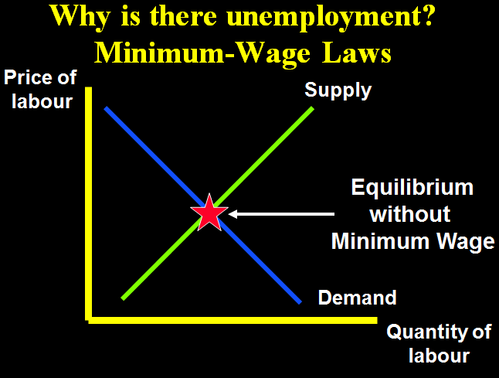
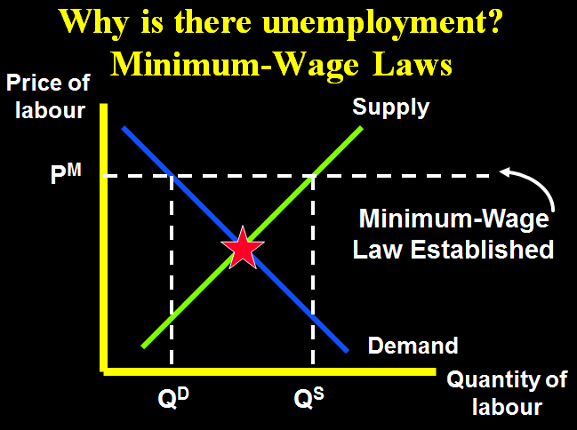
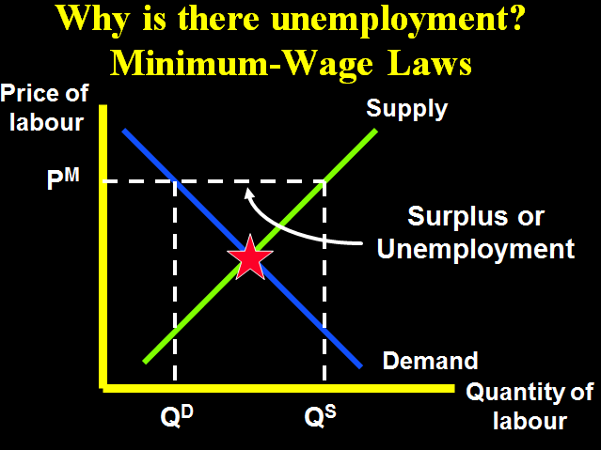
Minimum Wage Laws
When a minimum-wage law forces the wage to remain above the level that balances supply and demand, it creates a surplus of labor.

Slide 26
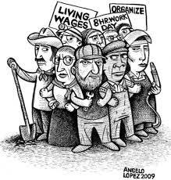
Union
A union is a worker association that bargains with employers over wages and working conditions.
  A union is a type of cartel.
  Unions exert their market
  power to negotiate higher
  wages for workers.
  The typical union worker earns
  20% higher wages and gets
  more benefits than a nonunion
  worker for the same type of work.

Slide 27
Employment situation under union
When unions raise the wage above equilibrium, quantity of labor demanded falls than quantity supply of labor and hence unemployment results.
“Insiders” → workers who remain employed,
they are better off
“Outsiders”→ workers who lose their jobs,
they are worse off
Some outsiders go to non-unionized labor markets, which increases labor supply and reduces wages in those markets.

Slide 28
Are unions good or bad for the economy?
Are unions good or bad?
Critics:
Unions are cartels. They raise wages above equilibrium, which causes unemployment and/or depresses wages in non-union labor markets.
Advocates:
Unions counter the market power of large firms, make firms more responsive to workers’ concerns

Slide 29
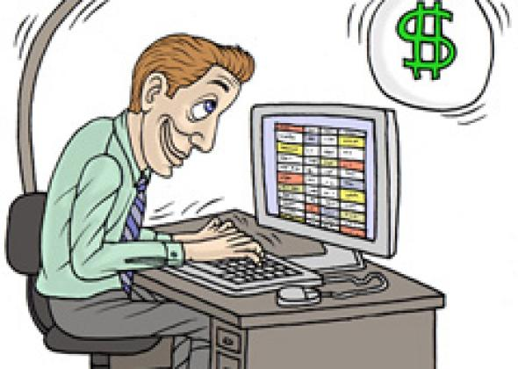
Efficiency Wages
The theory of efficiency wages:
Firms operate more efficiently if wages are above the equilibrium level.
Firms voluntarily pay above-equilibrium wages to boost worker productivity.
But in the case of unions and minimum wage laws, firms that pay above-equilibrium wages do so involuntarily.

Slide 30
Four reasons why firms might pay efficiency wages:
1. Worker health
Paying higher wages allows workers to eat better, makes them healthier, more productive.
Worker turnover
Hiring & training new workers is costly.
Paying high wages to existing workers gives more incentive to stay, reduces turnover.
Worker quality
Offering higher wages attracts better job applicants, increases quality of the firm’s workforce.
Worker effort
If market wage is above equilibrium wage, there aren’t enough jobs to go around, so workers have more incentive to work not shirk.

Slide 31
Cyclical Unemployment
Cyclical unemployment is caused by a decline in total spending and is likely to occur in the recession phase of the business cycle.

